Slide 1
Control and Communications Systems Diagram
Arduino
Serial
Sonar (Future System)
Memory
Micro SD Card
I2C
IMU Fusion 9 DOF board
I2C
Barometric Pressure
Temperature
Altitude Sensor
PI
USB
Cell phone + GPS board
GPS Antenna
Serial
CELL Antenna
Sim Card
PWM
Motor Shield
PWM
Motor Controller 1
Motor 1, Front Right Fin
PWM
Motor Controller 2
PWM
Motor 2 Front Left Fin
PWM
Motor Controller 3
PWM
Motor 3 Rear Fins
This document is confidential and proprietary to Deep-Sea X-plorers LLC

Slide 2
Power Distribution Diagram
Battery
Lithium
3.6 volts
3.6 VDC
Cell phone + GPS board
Battery
NiMh
3.6 Volt
3.6 VDC
Arduino Shield
Motor Control
3.6 VDC
Arduino
5 VDC
IMU Fusion 9 DOF board
PI
3.3 VDC
Barometric Pressure
Temperature
Altitude Sensor
Battery 9VDC
9 VDC
5 VDC
Sonar (Future System)
This document is confidential and proprietary to Deep-Sea X-plorers LLC

Slide 3
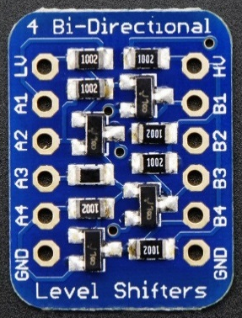
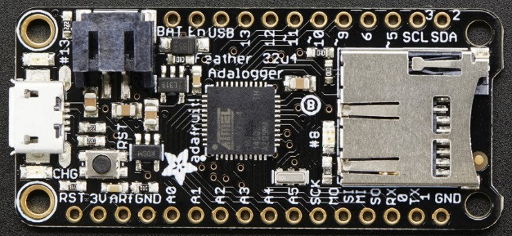
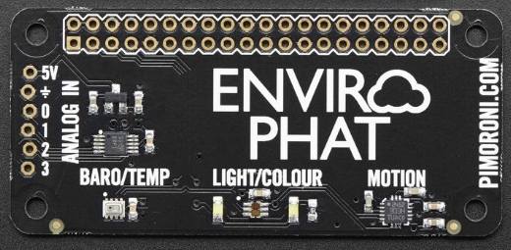
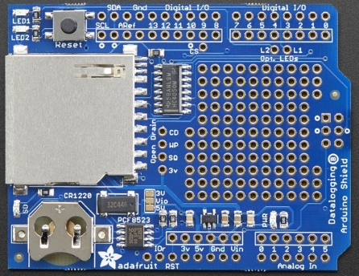
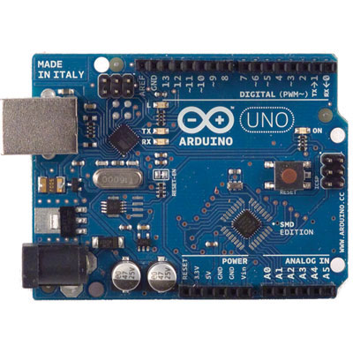
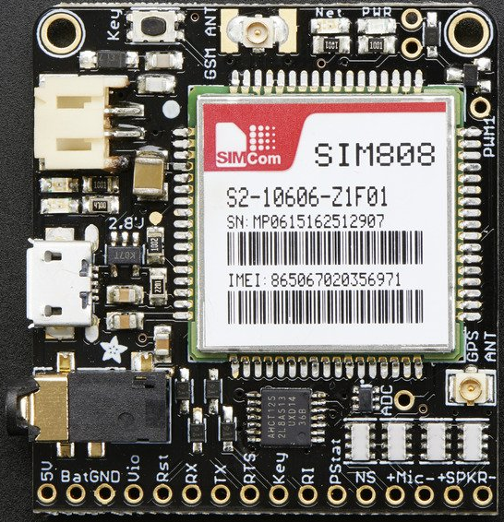
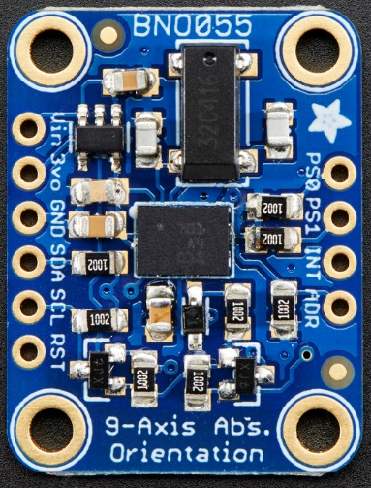
This document is confidential and proprietary to Deep-Sea X-plorers LLC

Slide 4
Pressure Transducer

